Slide 2
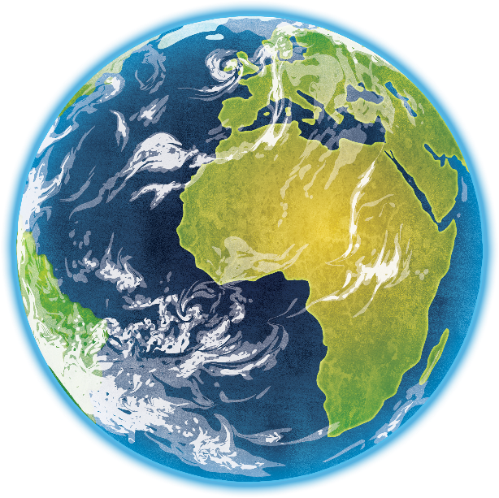
What is the Sun?
The Sun is a huge star that Earth and the other planets in our solar system orbit around.
Unlike other stars, the Sun is close enough for us to feel its heat.
Our Sun is just one star amongst billions of others!

Slide 3
Why is the Sun Hot?
The Sun’s core is around 15 million degrees Celsius!
It is a huge ball of gas full of ongoing nuclear reactions which emit massive amounts of heat, light and energy in to space!
The Sun’s light is so bright that it can damage your eyes if looked at directly.

Slide 4
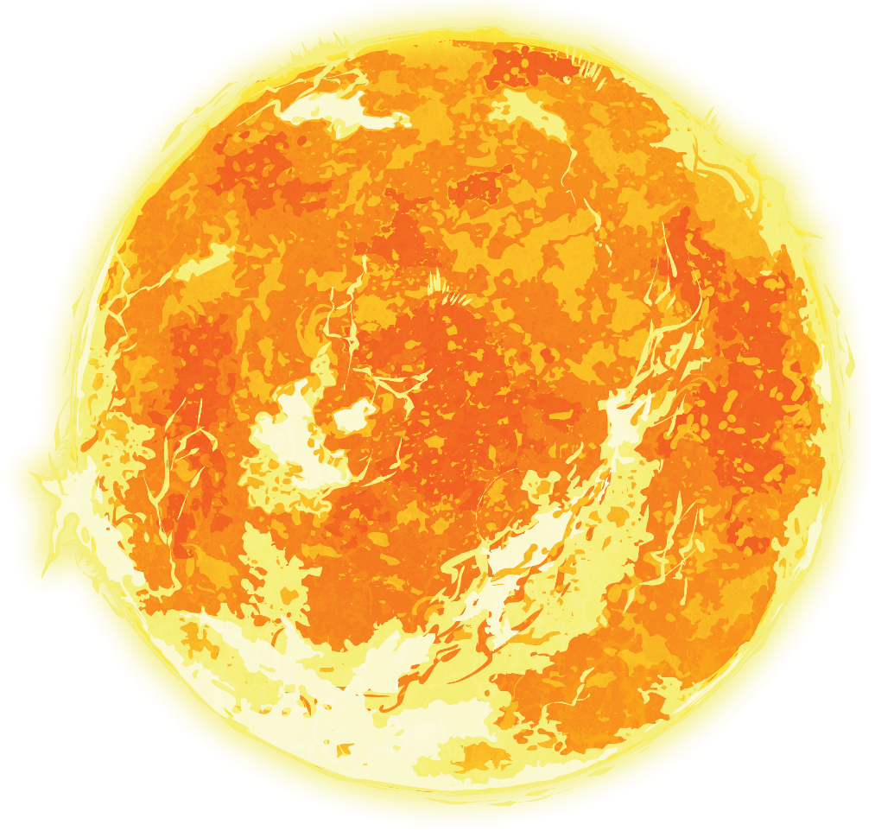
How Big is the Sun?
The sun is 1.4 million km wide!
It is over a million times bigger than the Earth and 300,000 times heavier!

Slide 5
Why Do the Planets Orbit Around the Sun?
The Sun has a staggeringly powerful gravity force which pulls the planets in space towards itself.
This same force keeps us all on Earth.

Slide 6
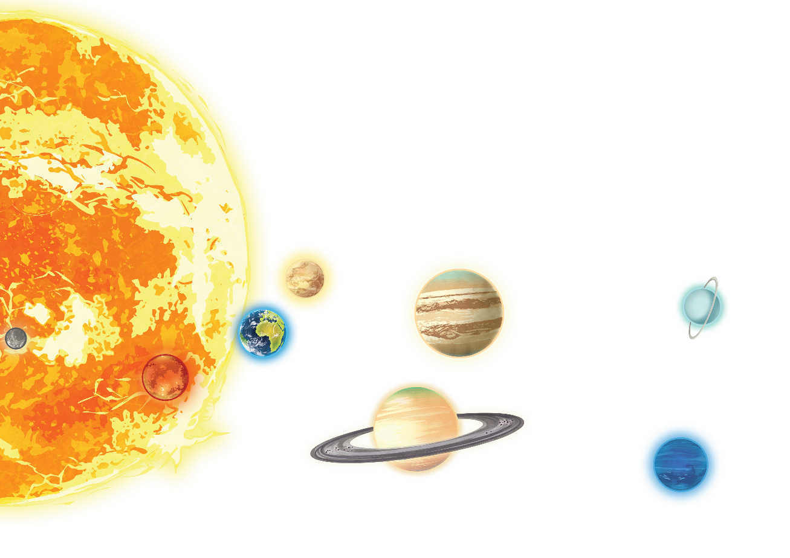
How Far Away is the Sun?
The Sun is 150 million km/ 93 million miles away from the Earth.
It takes the Sun’s light just over 8 minutes to actually reach the Earth, so what we see of the Sun right now is like a photograph of it.
Light travels at 300,000 km per second.

